Slide 1

SINGLE IMAGE SUPER RESOLUTION
Group 3: Nguyen Dang Duy 20210272
Hoang Van Khang 20210466
Bui Duc Viet 20215254

Slide 2
TABLE OF CONTENTS
01
02
03
INTRODUCTION
SISR DETAILS
General idea of Single-image Super-resolution problem
Fundamental knowledge relevant to problem
METHODS & ALGORITHMS
Some methods and algorithms to solve problem
04
05
DEMO
COMPARISION
Demo solutions
Comparision between methods in different scenarios

Slide 3
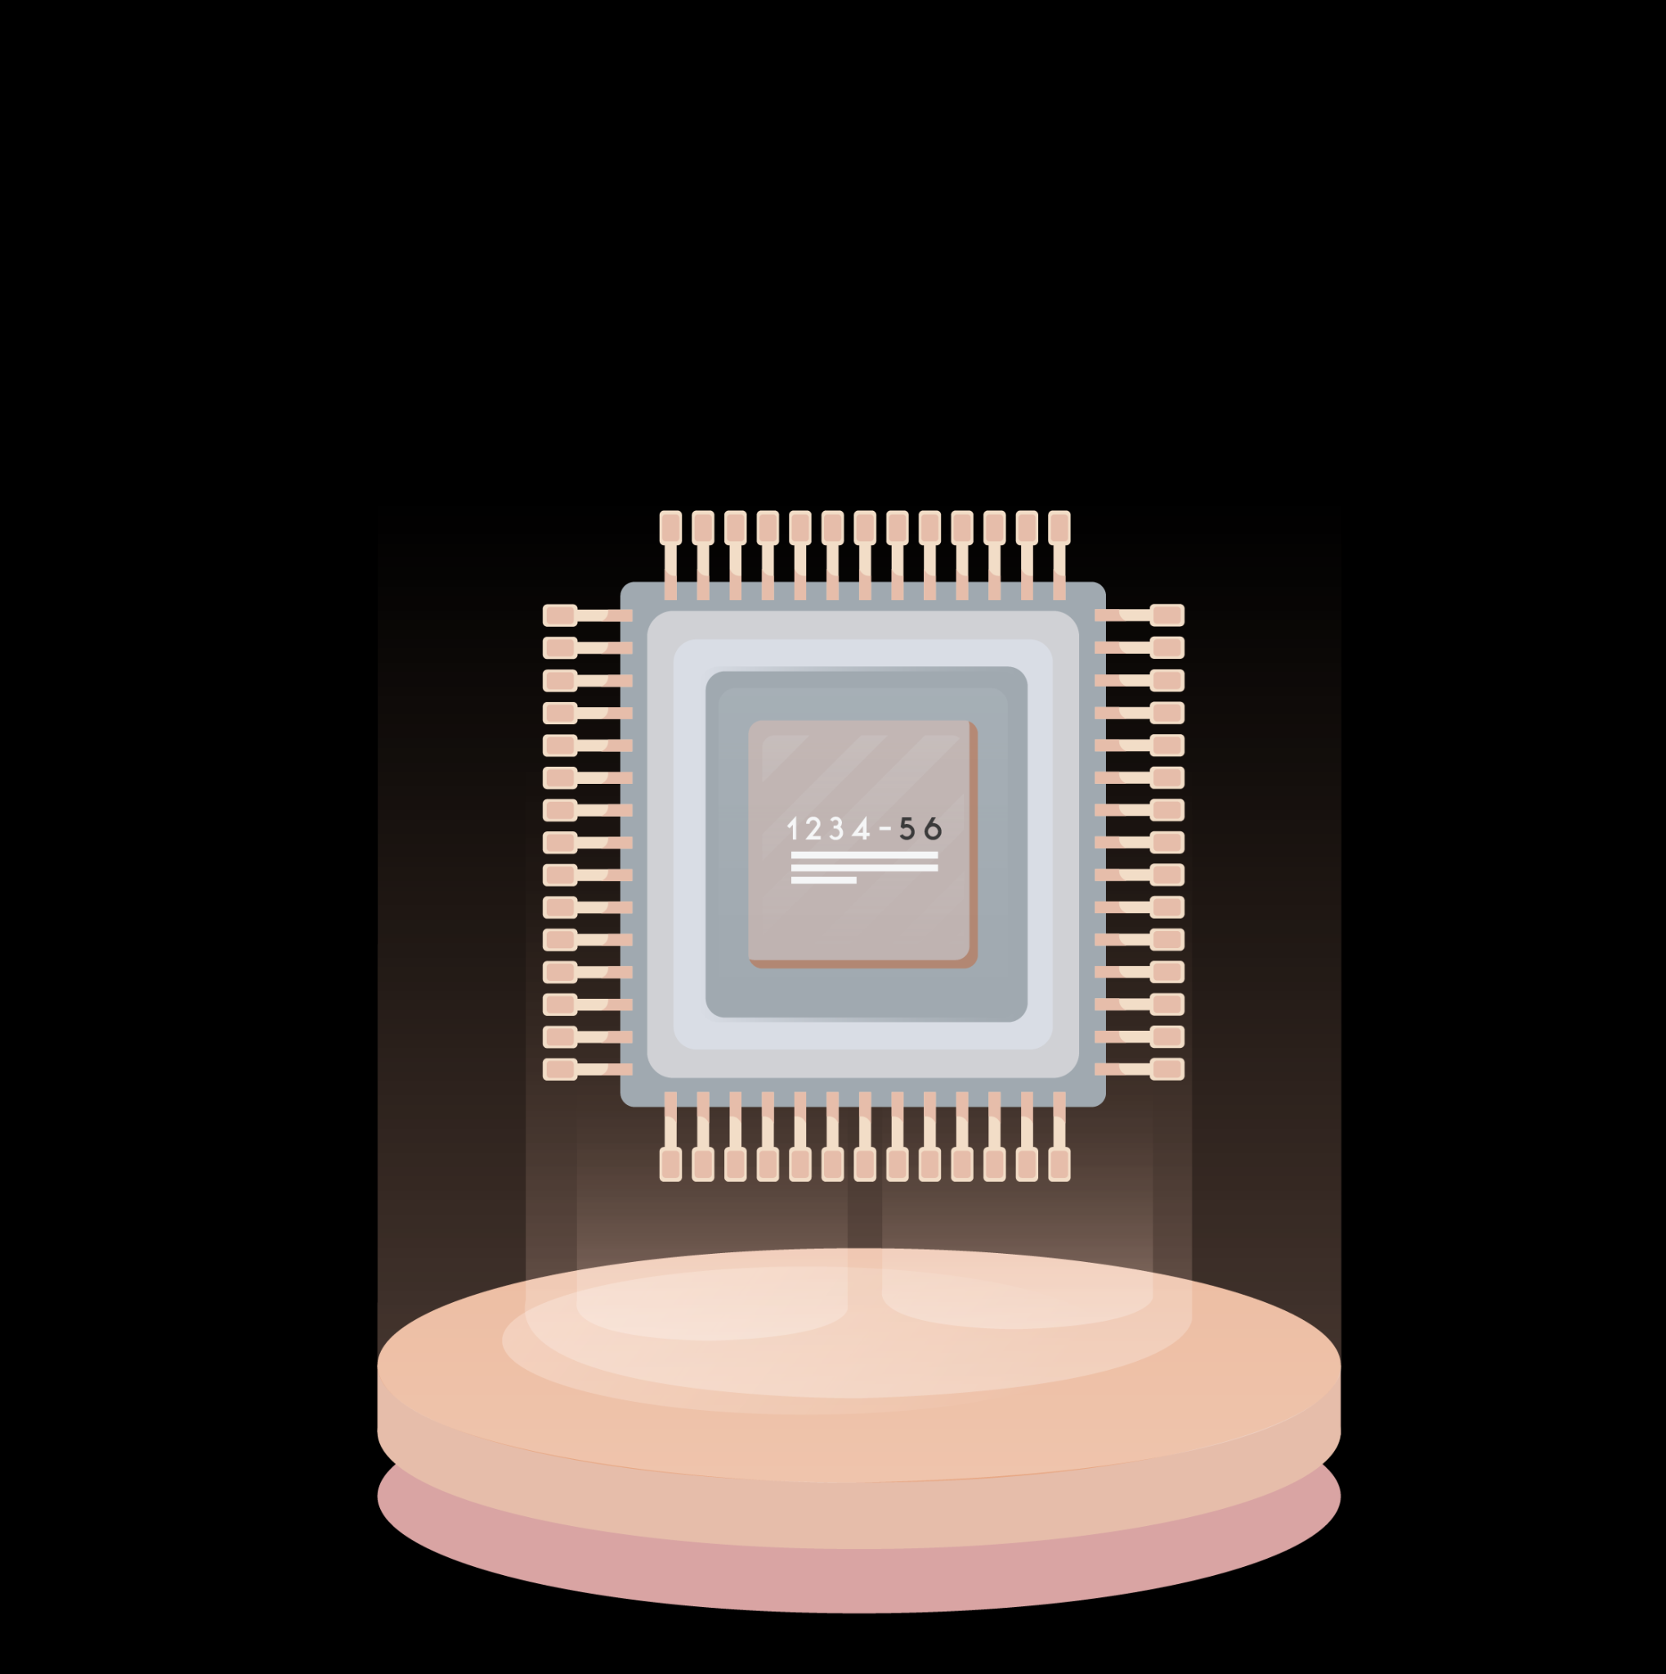
01
INTRODUCTION
SINGLE IMAGE SUPER RESOLUTION

Slide 4


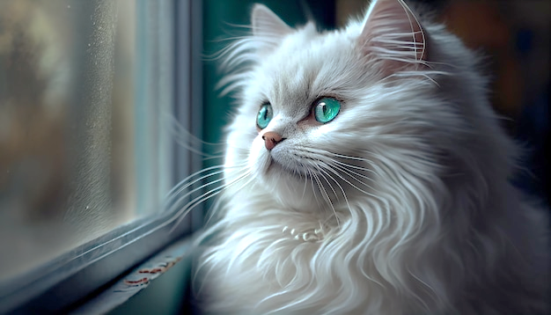
SINGLE IMAGE SUPER RESOLUTION (SISR)
It is a computer vision task that reconstructs a high-resolution (HR) image from low-resolution (LR) image.

Slide 5
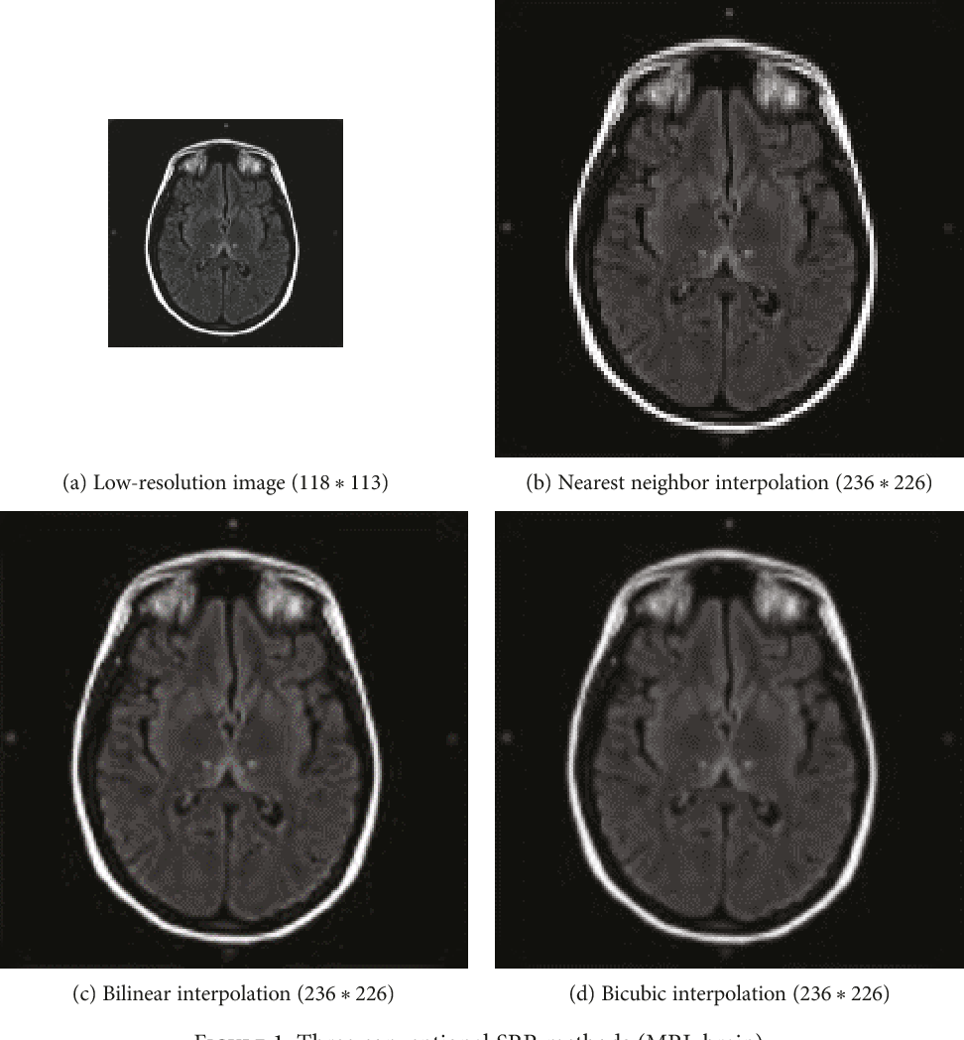
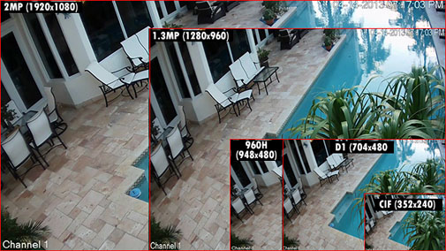
Application of SISR
Improve quality of medical image
Improve quality of satellite image
Security footage

Slide 6

02
SISR DETAILS
Fundamental knowledge relevant to SISR problem

Slide 7
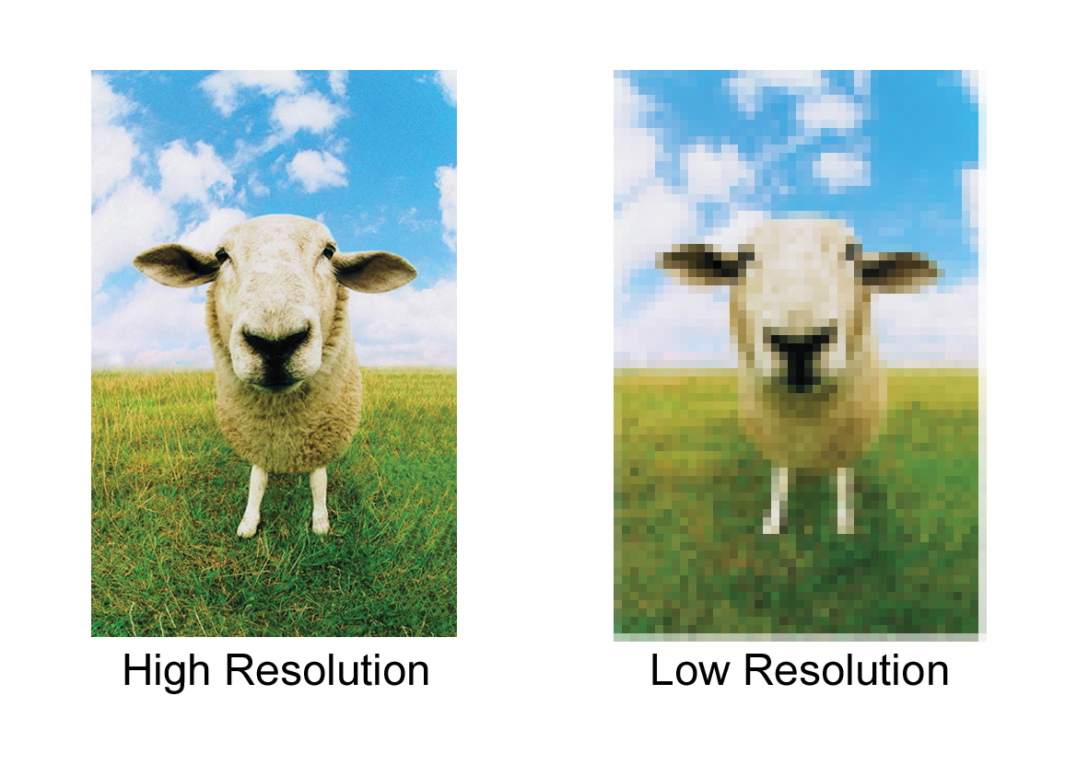
High-resolution .vs Low-resolution
Low-resolution (LR) image: An image with a lower pixel count, resulting in less detail and more visible artifacts.
High-resolution (HR) image: The desired output image with a higher pixel count, greater detail and fewer artifacts

Slide 8
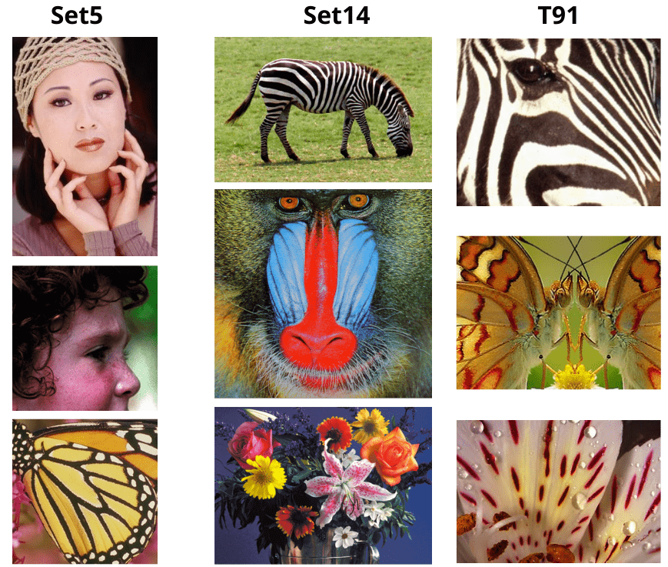
Dataset
Classical Dataset: Set5, Set14, BSDS100, DIV-2K,…
Synthetic dataset: Create from various 4k video

Slide 9
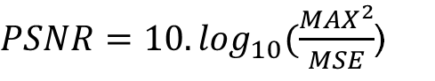
Evaluation metric
Peak Signal-to-Noise Ratio
- PSNR is a widely used metric to measure the quality of a reconstructed or compressed image compared to the original image
Peak Signal-to-Noise Ration is defined as:
$PSNR=10.\log_{10}(\frac{{MAX}^{2}}{MSE}$)
where: MAX is the maximum possible value of pixel in the image (always 1 or 255)
MSE is average square differences between pixel values of original and reconstruct image

Slide 10
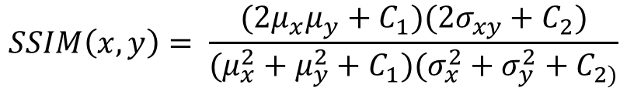
Evaluation metric
Structural Similarity Index
- SSIM is used to measure the similarity between two images.
- More accurate assessment of image quality compared to traditional metrics
- SSIM is particularly useful in image processing tasks
$$SSIM\left(x,y\right)= \frac{(2μ_{x}μ_{y}+C_{1})(2σ_{xy}+C_{2})}{(μ_{x}^{2}+μ_{y}^{2}+C_{1})(σ_{x}^{2}+σ_{y}^{2}+C_{2)}}$$
- C1, C2 are constants

Slide 11
Evaluation metric
Mean opinion score
The Mean Opinion Score (MOS) is a measure used to evaluate the quality of speech, audio, or video, based on subjective assessment by human participants.
The MOS is typically calculated by asking a group of users to rate the quality of a sample on a predefined scale, often from 1 to 5
The scores from all participants are then averaged to produce the MOS.

Slide 12
03
METHODS & ALGORITHMS

Slide 13
3.1 Classical approach- Image processing
Using pure-math methods for making higher resolution images. Interpolation methods were considered since it reconstructs the new image based on the pixel values in the old one
Nearest neighbor
Bilinear
Interpolation
Bicubic
Interpolation

Slide 14
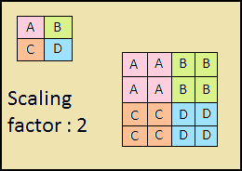
3.1.1 Nearest neighbor
Idea
This method uses the value of the nearest pixel to fill in the blank pixel in the new image.
Advantage
The idea of nearest neighbor is simple, and easy to implement, with the cheapest computation cost.
Disadvantage
However, the reconstructed image is not smooth at all

Slide 15
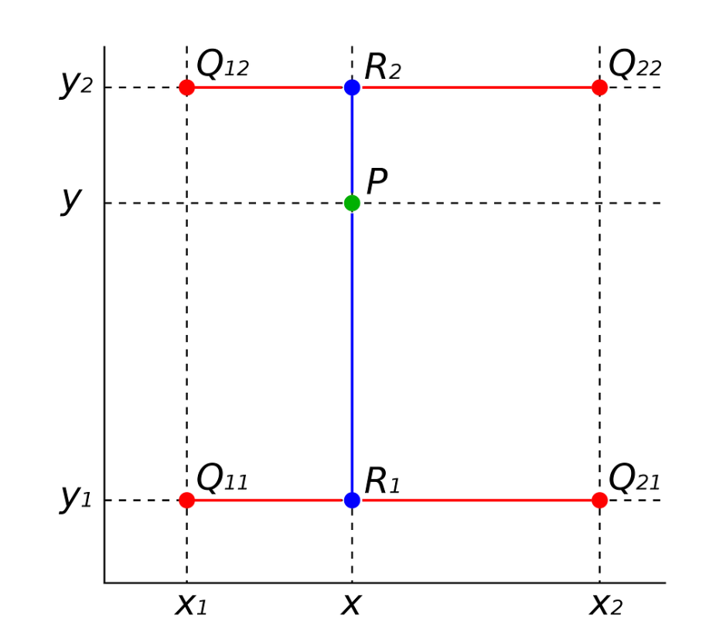
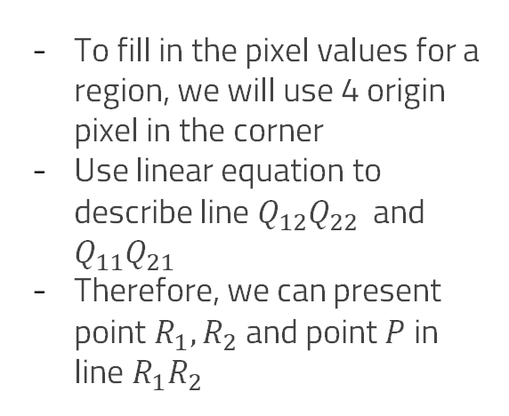
3.1.2 Bilinear interpolation
Idea
To fill in the pixel values for a region, we will use 4 origin pixel in the corner
Use linear equation to describe line $Q_{12}Q_{22}$ and $Q_{11}Q_{21}$
Therefore, we can present point $R_{1}, R_{2}$ and point $P$ in line $R_{1}R_{2}$

Slide 16
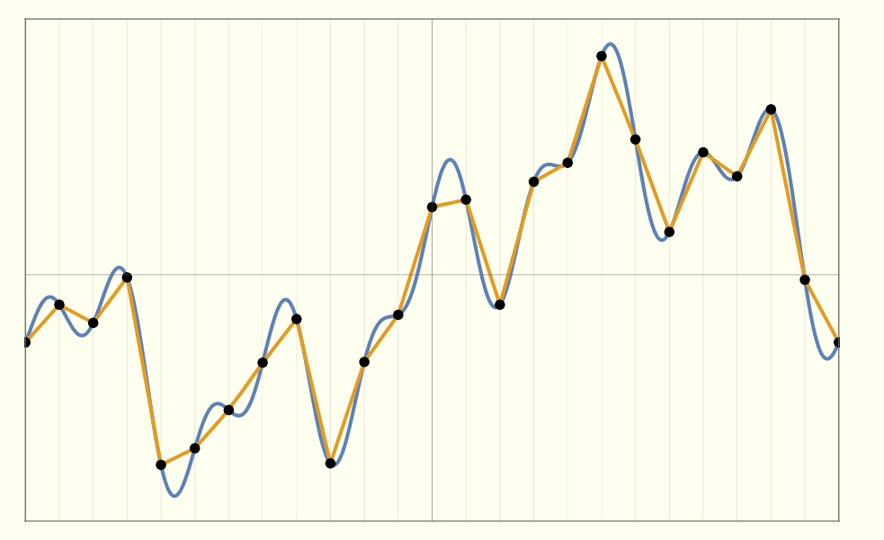
3.1.2 Bilinear interpolation
Bilinear are better than nearest neighbor, and the reconstructed image has higher quality.
However, the curves we got are not smooth enough

Slide 17
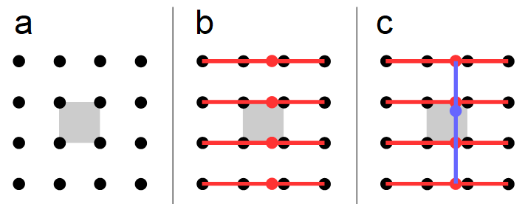
3.1.3 Bicubic Interpolation
Using cubic equations instead of linear equations to interpolate
16 nearest origin pixels will be used to fill in the blank
The most method used to rescale the image.

Slide 18
3.2 Deep learning- CNNs
- If the scale factor greater than 2, output images are very smooth, devoid of sharp edges.
- Interpolation technique is not adding any new information to the signal.
- This can be changed with aid of learning-based techniques
SRCNN
ESPCN
VDSR
Super Resolution
Convolutional Neural Network
Efficient Sub-Pixel
Convolutional Network
Very Deep
Super Resolution

Slide 19
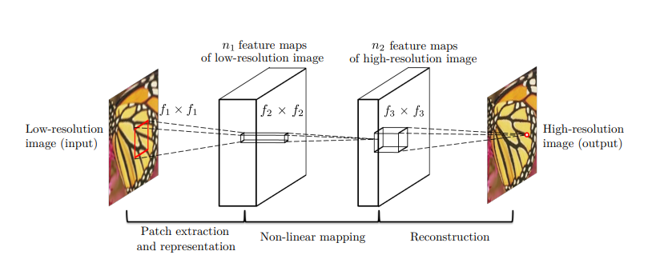
3.2.1 SRCNN
Idea: Upscale the low-resolution image to desired size using bicubic
- Learn a mapping F to map the interpolated image with the ground-truth HR image

Slide 20
3.2.1 SRCNN
Input
Interpolated image
CONV 9x9, 64
CONV 1x1, 64
CONV 5x5, 64
ReLU
Output
HR image

Slide 21
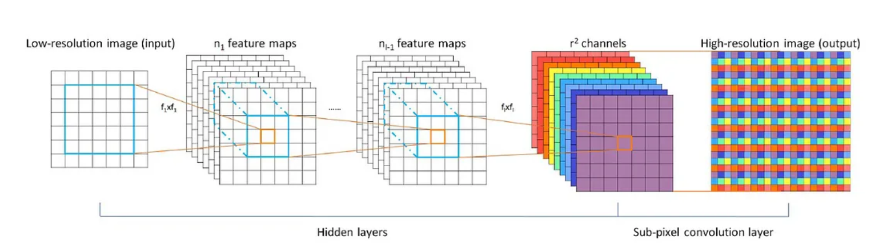
3.2.2 ESPCN
Idea: Avoid upscaling the LR image before feature extraction
- Network followed by a sub-pixel convolutional layer to upscale LR feature maps

Slide 22
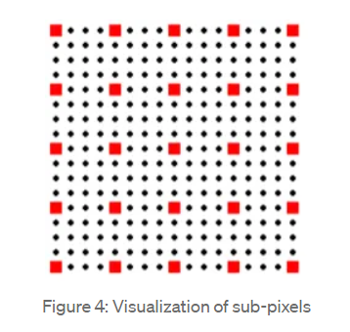
3.2.2 ESPCN
Sub-pixel convolutional
Due to the limitation of the light sensor, images are limited to the original pixel resolution.
In the microscopic world there are numbers of tiny pixels between the two physical pixels

Slide 23
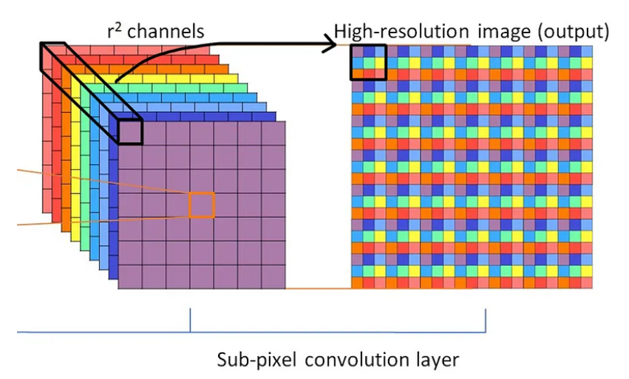
3.2.2 ESPCN
Sub-pixel convolutional

Slide 24
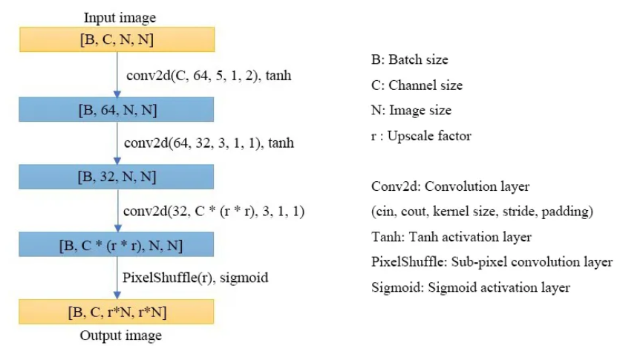
3.2.2 ESPCN
L-1 layers are convolutional layers which obtain features map of the input LR images
The last layer is an efficient sub-pixel convolutional layer to recover the output image size

Slide 25
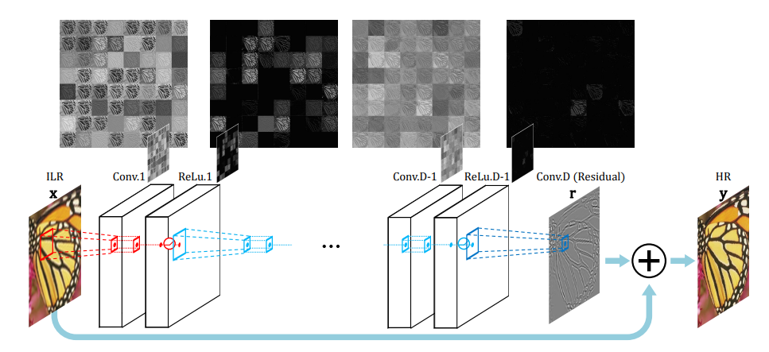
3.2.3 VDSR
Idea: Inspired by the VGG-net used for ImageNet classification
- 20-layer network that significantly improves super-resolution accuracy by leveraging contextual information

Slide 26
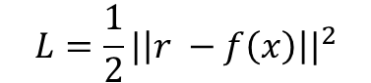
3.2.3 VDSR
Residual learning
- Loss function
$$L=\frac{1}{2}{|\left|r −f\left(x\right)\right||}^{2}$$
where: r = y - x
f(x) is the output of CNN with x is the LR image
This loss function show that VDSR try to predict the difference between LR image and HR image.

Slide 27
3.3 Generative models
One of the most notable achievements of generative models is their ability to generate realistic images
There have been countless proposals regarding SSIR, all of them leading to astonishing results.
dSRVAE
SRGAN
Real ESRGAN
Denoising Super-Resolution Variational AutoEncoder
Single Image Super-Resolution Using a Generative Adversarial Network
Training Real-World Blind Super-Resolution
with Pure Synthetic Data

Slide 28
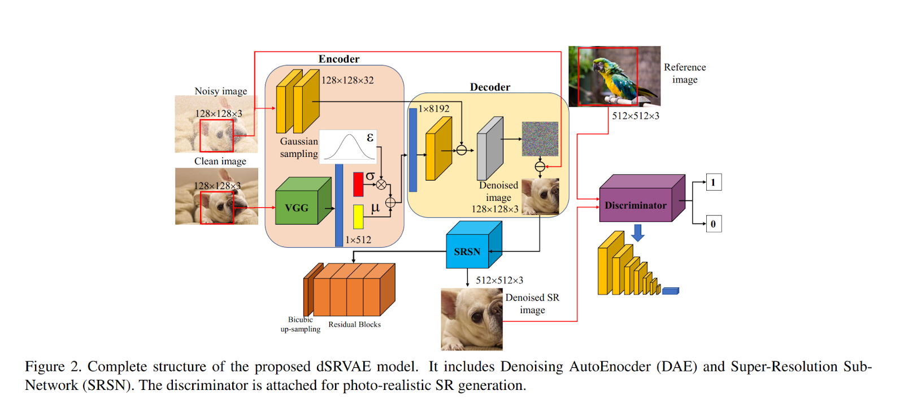
3.3.1 dSRVAE
Combines Variational AutoEncoder (VAE) and Generative Adversarial Network (GAN) to jointly perform image denoising and super-resolution.

Slide 29
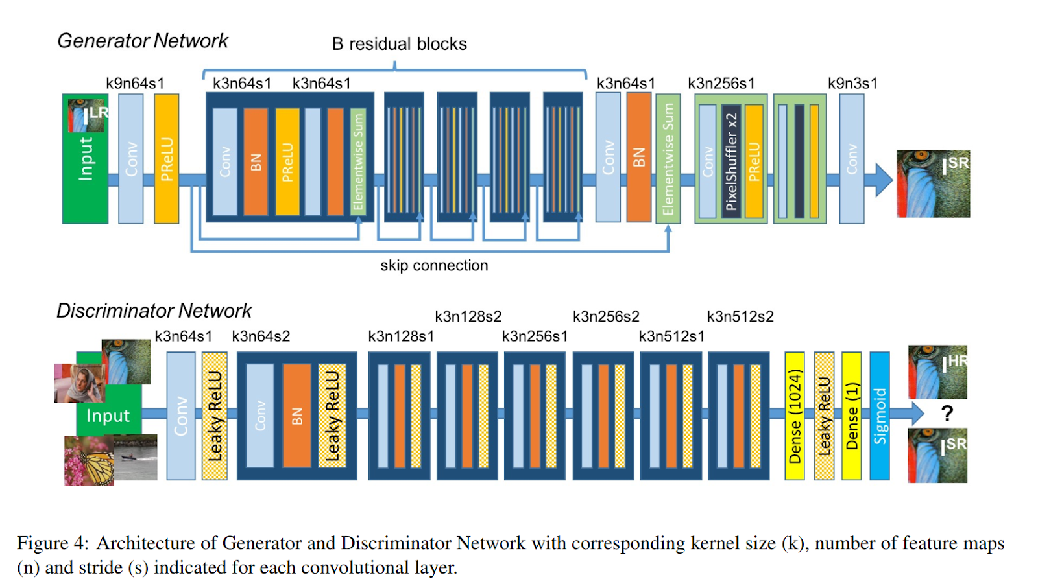
3.3.2 SRGAN
1st GAN model for SISR
Able to recover the finer texture details of the low-resolution images -> Making SR image more realistic

Slide 30
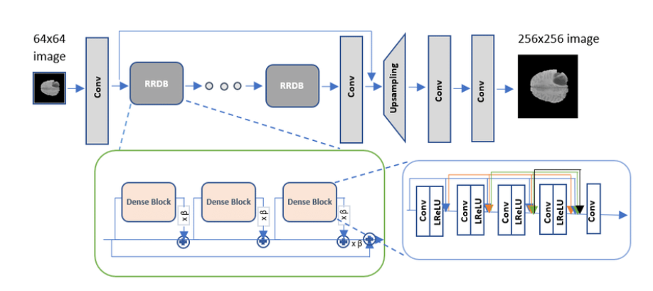
3.3.3 Real-ESRGAN
Significant improved version of SRGAN
Use in practical applications (Restore images, Super-resolution for videos (Specially for cartoon and anime movies)

Slide 31
04
DEMO
DEMO SOLUTION

Slide 32
05
Comparision
Comparision between methods

Slide 33
Image processing
.vs
CNNs
.vs
Generative models

Slide 34
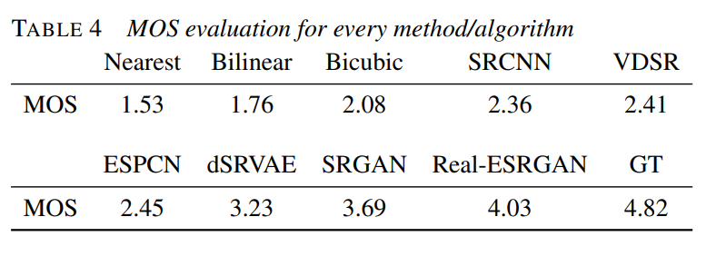
Highest MOS - GAN models
Generative models get the highest MOS. It means that images generated by the GAN network look the most realistic according to the survey participants

Slide 35
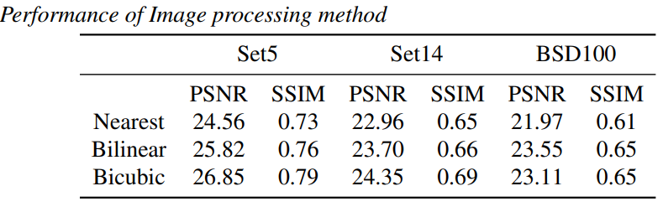
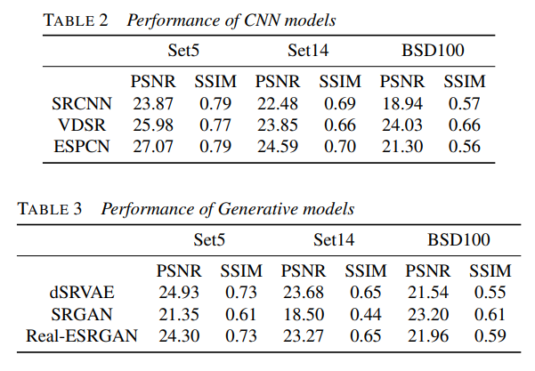
Highest MOS – GAN Models
GAN models get the worst score of PSNR and SSIM evaluated in the same datasets with 2 remaining methods
The most complex method, requiring too much time and resources for training

Slide 36
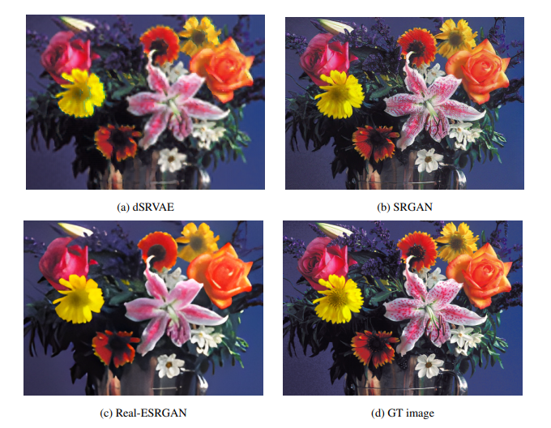
Highest MOS – GAN Models

Slide 37
The easiest - Image processing
The simplest to implement, requires the least memory resources, and has the shortest execution time.
However, the effectiveness of the image processing method is not particularly high
This method still plays an important role as it aids in preprocessing images for the CNN-based method

Slide 38
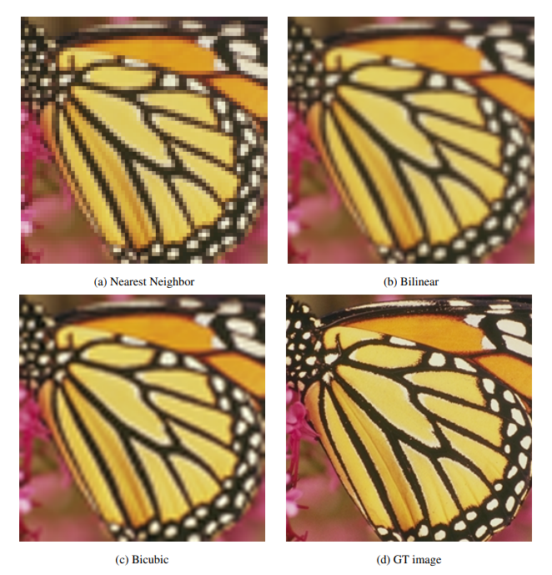
The easiest - Image processing

Slide 39
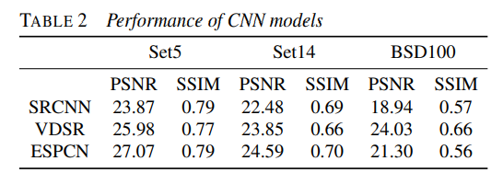
CNNs Method
The CNN-based method yields more promising results than the basic image processing method.
Training a CNN can be performed with a GPU, and the output images from the CNN are good enough for various purposes.

Slide 40
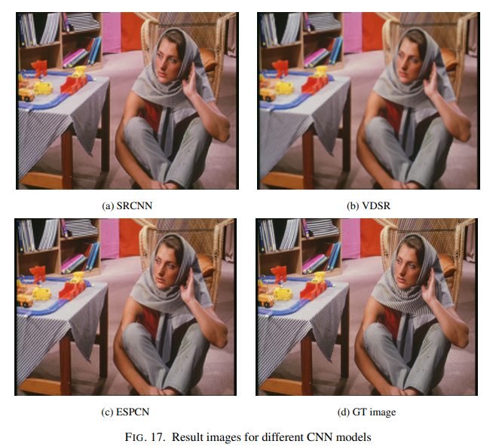
CNNs Method
Some methods, such as SRCNN and VDSR, have the drawback that the input images need to be upscaled using bicubic interpolation before passing through the network layers

Slide 41
Recomendation
To apply into real-time processing, consider employing image processing techniques such as Bicubic interpolation or compact Convolutional Neural Networks like SRCNN or ESPCN, which offer lower computational complexity and easy for practical implementation.
To achieve the highest possible image quality without being restricted by time, it’s crucial to explore advanced techniques such as generative models(GAN, Diffusion model).

Slide 42
Recomendation
By combining datasets like DIV2K with synthetic ones that include realistic noise and blur effects, we can create a powerful simulation of real-world conditions. This enhancement greatly increases the practicality and applicability of the model across various fields of application.
Some of State-of-the-art methods like Super-Resolution using Diffusion model or Vision Transformer should be consider for study (Due to the complex nature and significant resource demands of these (SOTA) methods, we have made the decision to exclude them from our report)

Slide 43
THANKS!

